Slide 1

Optimisation of university space based on a supply and demand analysis
A case study on staff meeting rooms and student toilet facilities on campus
Group 3
Abhinav Sharma
Advait Deshpande
Xinyi Xu
Yanming Wang
MAST90107

Slide 2
Project Members
Abhinav Sharma
Problem Formulation
Algorithm Design & Implementation
Advait Deshpande
Hyperparameters tuning
Clustering algorithms
Yanming Wang (Ethan)
Algorithm adaption for buildings
Collecting results for buildings
Xinyi Xu (Katie)
Algorithm adaption for floors
Collecting results for floors
Group 3

Slide 3
Client
Spatial Analytics and Space Management department of the University of Melbourne
This department works in
future space design
better space allocation
optimizing usage of resources for the university
Anbin Hou, Project Manager
Jade Germantis, Program Manager

Slide 4
Expected Outcome
Suggest how the space arrangement of meeting rooms and toilets can be optimized
Deliver a detailed analysis report with interpretations
Use different analytical methods
Provide reasonable recommendations of space optimization opportunities

Slide 5
Challenges
Extensive analysis of supply and demand
Complicated data mutations, joins and preprocessing
Spatial data analysis using QGIS 3
Factors Analysis
Predictive modelling
Informative Path Planning
Formulating CSP
Creating novel problem solver
Clustering-based parameters tuning
Implementing algorithm in pyQGIS3
Data Science Research Objectives

Slide 6
Structure
Problem Description - Objective with Formulation
Data Analysis - EDA and Factors Analysis
Proposed Methodologies
Non-Randomized Anytime Orienteering Algorithm
Hyper-parameters tuning and Clustering Algorithms
Results
Spatial Algorithm Findings
Floor Algorithm Findings
Algorithm Analysis
Conclusion

Slide 7
Data Science
Exploratory Data Analysis
Pandas
Snsplots
Problem Formulation
Constraint-Satisfaction concept
Mathematical notations
Problem Solver
Cost-Reward representation
Priority queues
Hyperparameters tuning
Unsupervised learning
Clustering algorithms
Grid-space searching
Results collection
QGIS 3 Processing Framework
Google Colab
Tools/Techniques Used

Slide 8
Problem Description
Formally describing problem objectives with formulation

Slide 9
Problem Background
The number of existing meeting rooms and toilets is considered as “supply”.
The number of staff and enrolled students are considered as “demand”.
Proposing solutions that can efficiently use the current supply of resources.

Slide 10
Related Work
Informative Path Planning (IPP) Problems
Randomized algorithm for informative path planning with budget constraints - Arora, S. and Scherer, S. 2017
The Orienteering Problem - Bruce L. Golden, Larry Levy, and Rakesh Vohra, 1987
Correlated Orienteering Problem - Jingjin Yu, Mac Schwager and Daniela Rus, 2014
Informative Path Planning for Mobile Sensing with Reinforcement Learning - Wei, Y.; and Zheng, R. 2020
Min-Max Heaps and Generalized Priority Queues - Atkinson, M. D. 1986
Clustering Method Based on K-Means Algorithm - Youguo Li, 2012

Slide 11
Problem Objectives
Propose an optimization of university space based on a supply and demand analysis specific to staff meeting rooms and student toilet facilities
Analyze the spatial data, employee data, timetabling data, and meetings held data to advise if supply meets the demand
To propose an optimization of current university space for using supply-demand effectively
We aimed at devising solutions that can efficiently use the current supply of the resources
Problem Description

Slide 12
Transforming Objectives
General Objectives
Finding the k-best nearest buildings
Find the k-best nearest buildings from a particular building
Having a good supply of meeting room or student toilet facilities
Including factors like excellent conditions, COVID-19 lockdown, etc.
Finding the k-best nearest floors
Find the k-best nearest floors in a particular building
Having a good supply of meeting room or student toilet facilities
Including factors like excellent conditions, COVID-19 lockdown, etc.
Prediction Problems
We represented a general space optimization problem into more concrete strategy-based objectives
Problem Description

Slide 13



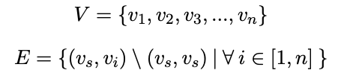
Problem Formulation: Variables
Let B be the travelling budget, O be the provided objectives, and F be the set of factors.
Let us assume a weighted directed specialized graph = (V, E) for n number of nodes where ∈ V is the pre-defined start node
Problem Description

Slide 14
Problem Formulation: Variables
Why specialized?
Problem Description

Slide 15
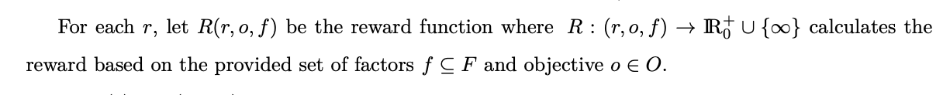
Problem Formulation: Variables
Problem Description

Slide 16




Problem Formulation: Equations
Hard-constraint Problem
Soft-constraint Problem with hyperparameter
Problem Description

Slide 17
Informal Solution
A set of ordered k-optimal goal nodes, such that the reward obtained by visiting the node is maximized while the path cost stays within a specified traveling budget B.

Slide 18
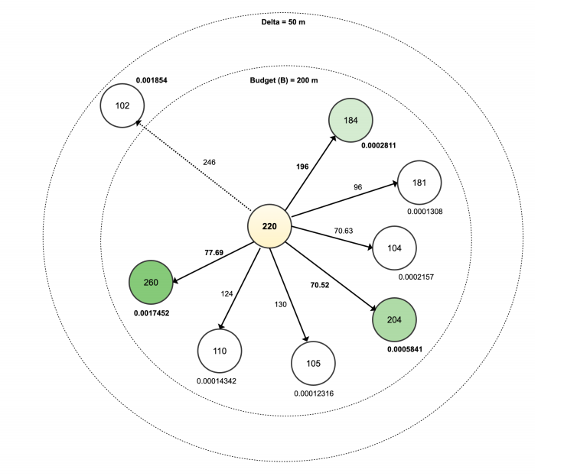
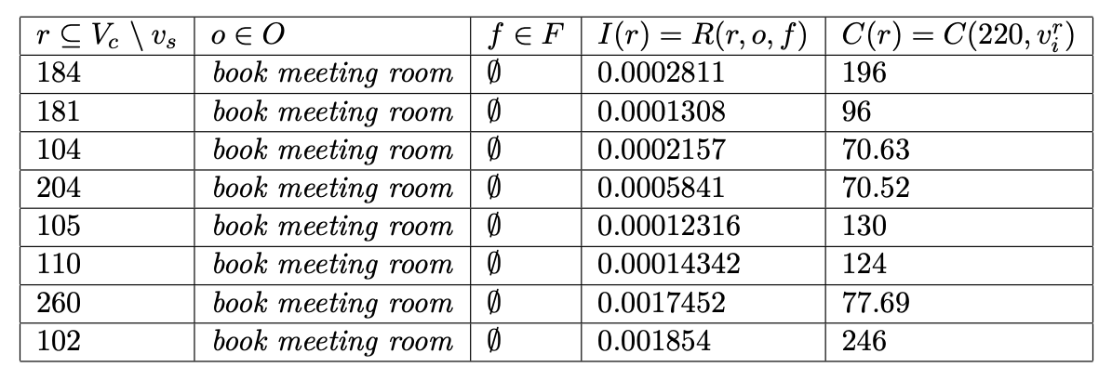
Problem Formulation: Finding k-best buildings
Problem Description

Slide 19
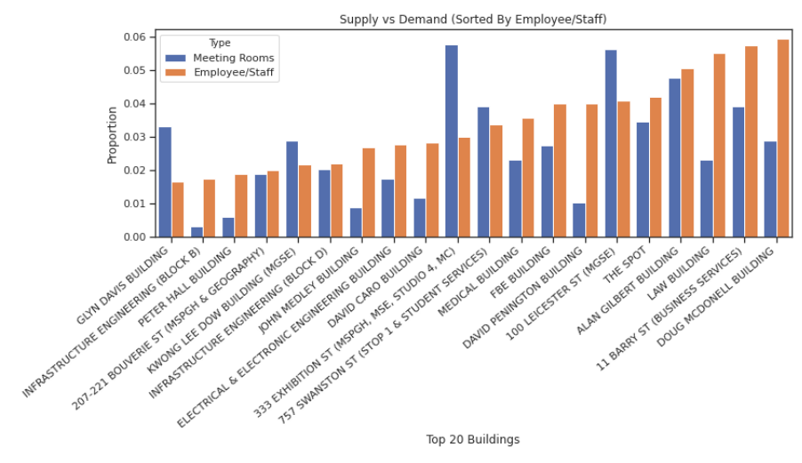
Data Analysis
Supply-demand charts for meeting rooms across buildings
Supply-demand charts for toilet facilities across buildings
Exploratory Data Analysis and Factors Analysis
This section was extensively focused in the Data Science Project Part-1

Slide 20

Factors/Preferences
Meeting Rooms Objective
COVID-19 Lockdown Situation
Strict Lockdown Situation (Demand - 0%)
Medium Lockdown Situation (Demand - 25%)
Low Lockdown Situation (Demand - 50%)
High Capacity: Average Room Size
Required Capacity(C): Average Room Size
With Equipment
Room Conditions
Easy Availability: Meeting Held
Data Analysis

Slide 21
Proposed Methodologies
Novel Algorithm with Hyperparameters Tuning

Slide 22
Formulated Problem
Hard-constraint Problem
Soft-constraint Problem with hyperparameter
Proposed Methodologies

Slide 23
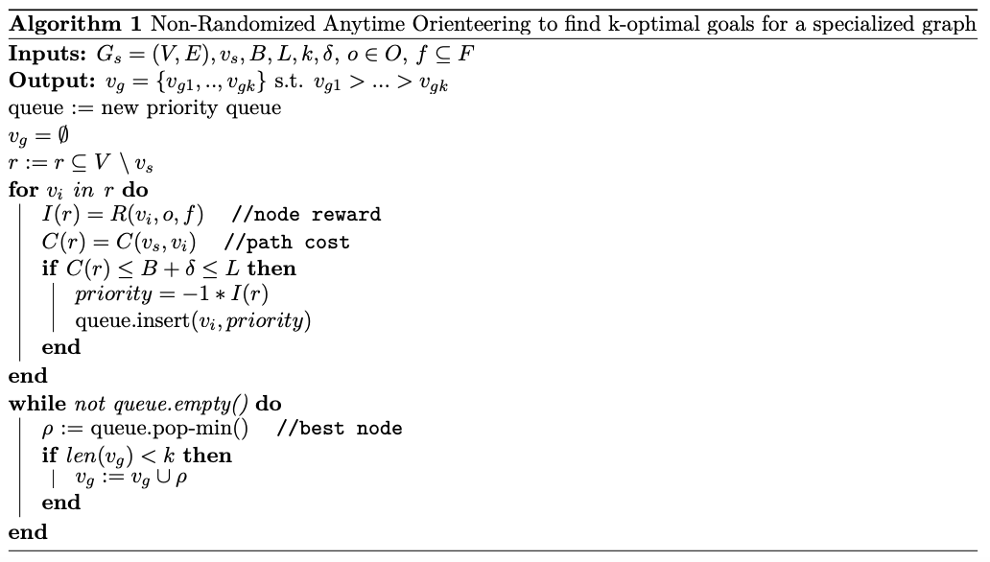
Solution: Non-Randomized Anytime Orienteering Algorithm
Proposed Methodologies

Slide 24
Algorithm: Cost Function
Finding k-most optimal nearest buildings
Finding k-most optimal nearest floors
Proposed Methodologies

Slide 25

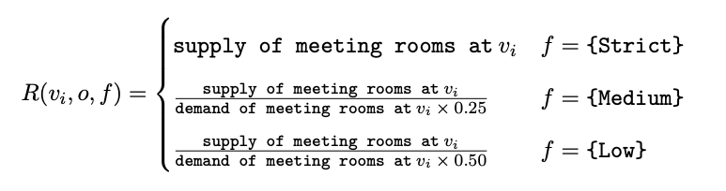
Algorithm: Reward Function
No factors
COVID-19 Lockdown Situation
Similarly, we enhanced the reward function for other factors/preferences
Proposed Methodologies

Slide 26


Algorithm: Complexities
Time Complexity
Space Complexity
Proposed Methodologies

Slide 27
Hyperparameters Tuning
Hyper parameters tuned using unsupervised learning technique called clustering.
It involves discovering the data by natural grouping.
Budget (B)
Relaxing Budget (delta)

Slide 28
Clustering Algorithms
Agglomerative Clustering - involves merging examples until the desired number of clusters is achieved. It is a part of a broader class of hierarchical clustering methods.
Birch - It incrementally and dynamically clusters incoming data points to produce the best quality clustering with the available resources (i. e., available memory and time constraints).
Mini batch K-Means - is a modified version of k-means that makes updates to the cluster centroids using random samples, making it faster to large datasets.
K-Means - most widely known clustering algorithm and involves assigning examples to clusters in an effort to minimize the variance within each cluster (Euclidean Distance).
Gaussian Mixture Models - summarizes a multivariate probability density function with a mixture of Gaussian probability distributions.
Proposed Methodologies

Slide 29
Hyperparameter tuning - Budget Constraint
Find the number of clusters using Silhouette technique.
Cluster the data using K-means algorithm(others used for comparison as well).
Average reward for each cluster is calculated and the cluster having highest reward is selected as budget.
The minimum value of the cluster’s range is the best radius.
Proposed Methodologies

Slide 30
Hyperparameter tuning - Delta Constraint
The range of delta parameter is the range of the cluster obtained from Budget parameter tuning.
Data points of the best cluster are retrieved and iterated over to find the high rewarding point.
Once, the data point is identified, it’s cost is subtracted from the radius obtained, giving the delta parameter
Proposed Methodologies

Slide 31
Results
max growth
Spatial and Floor Algorithm Findings

Slide 32
Finding k-optimal nearest buildings
Doug McDonell, Parkville
Other Buildings
Meeting Rooms Objective

Slide 33
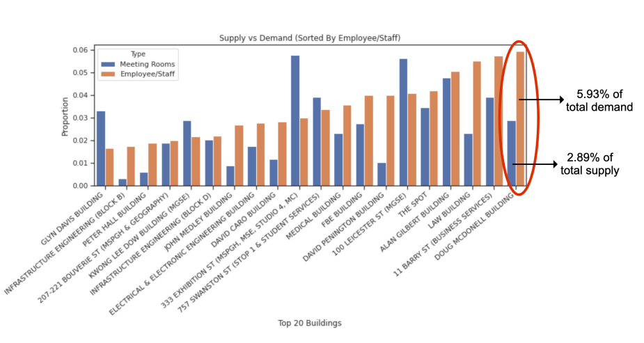
Finding k-most optimal buildings - Meeting Rooms Objective
Doug McDonell Building, Parkville
Results: Spatial Algorithm Findings

Slide 34
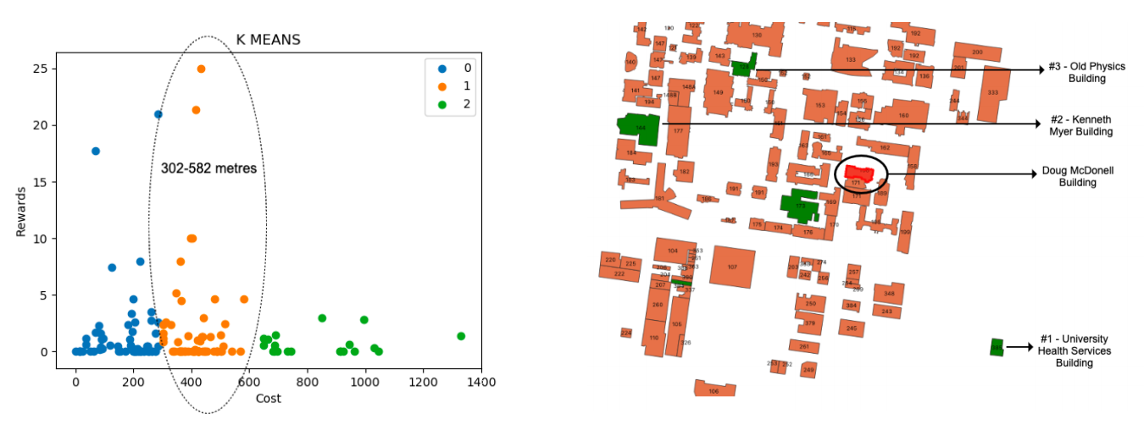
Finding k-most optimal buildings - Meeting Rooms Objective
Doug McDonell Building, Parkville
A staff member needs to walk at least 302-582 metres (Budget) from Doug McDonell Building to get most rewarding buildings with adequate supply of meeting rooms
Results: Spatial Algorithm Findings

Slide 35
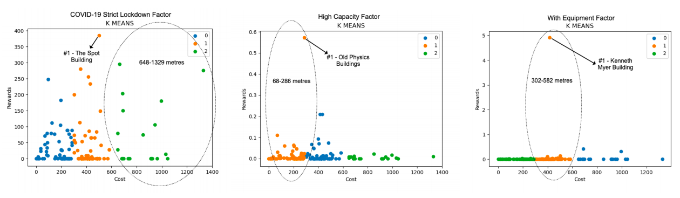
Finding k-most optimal buildings - Meeting Rooms Objective
Doug McDonell Building, Parkville
Results: Spatial Algorithm Findings

Slide 36
Finding k-most optimal buildings - Meeting Rooms Objective
Other Buildings
11-Barry St, Parkville: A staff member needs to walk at least 543-831 metres (Budget)
University Health Services is the most rewarding building with cost 668 metres
Law Building, Parkville: A staff member needs to walk at least 337-665 metres (Budget)
Old Physics Building is the most rewarding building with high capacity factor
FBE Building, Parkville: A staff member needs to walk at least 662-1274 metres (Budget)
Kenneth Myer Building is the most rewarding building for with equipment factor
Werribee Pathology Building, Werribee: A staff member needs to walk at least 43 metres (Budget)
Werribee learning & teaching building is the most rewarding building with cost 33 metres
This can be further extended to other buildings and more campuses
Results: Spatial Algorithm Findings

Slide 37
Finding k-optimal nearest buildings
Redmond Barry, Parkville
Other Buildings
Toilet Facilities Objective

Slide 38
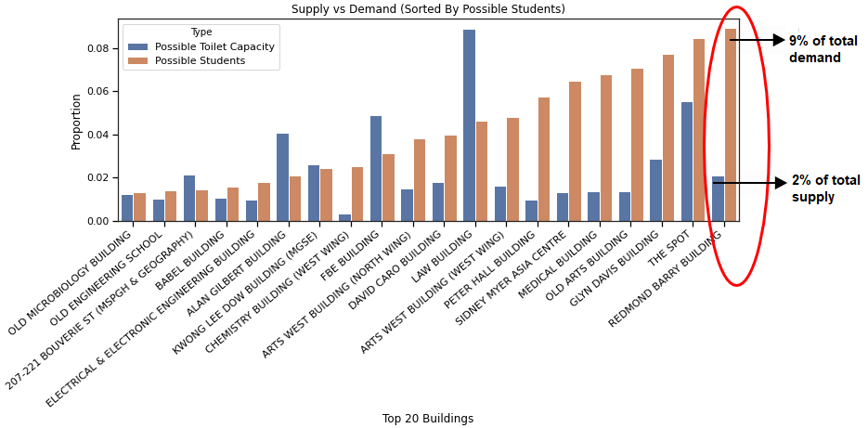
Finding k-most optimal buildings - Toilet Rooms Objective
Redmond Barry Building, Parkville
Results: Spatial Algorithm Findings

Slide 39
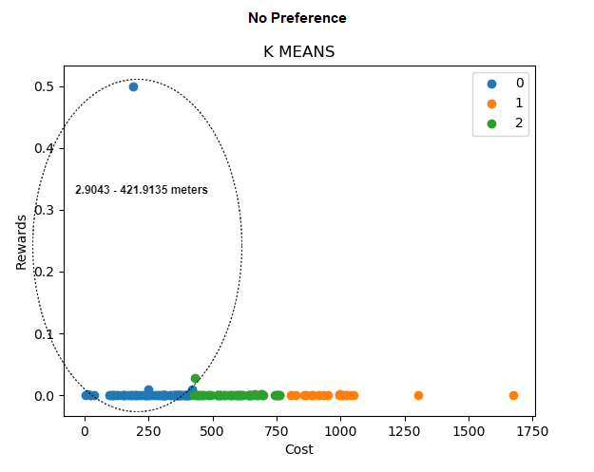
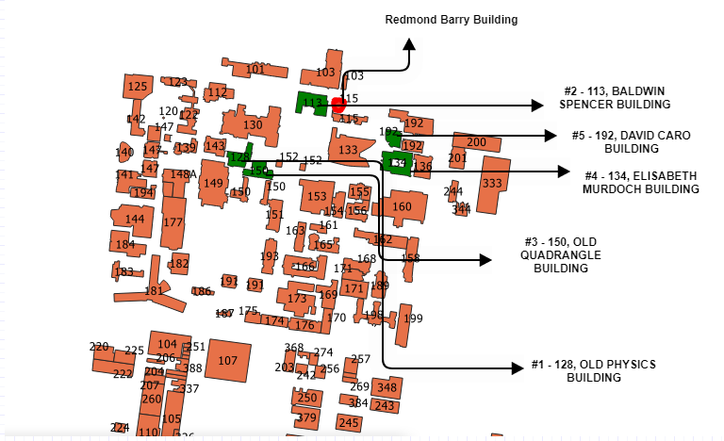
Finding k-most optimal buildings - Toilet Rooms Objective
Redmond Barry Building, Parkville
A student needs to walk at least 3 - 422 metres (Budget) from Redmond Barry Building to get most rewarding buildings with adequate supply of toilet facilities
Results: Spatial Algorithm Findings

Slide 40
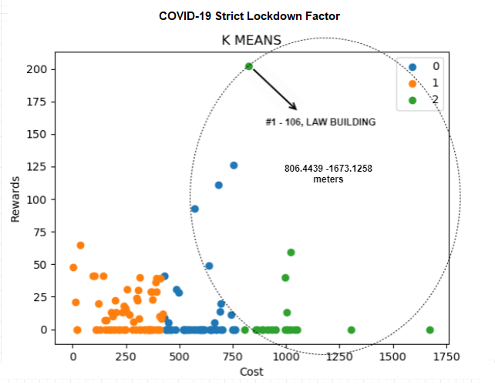
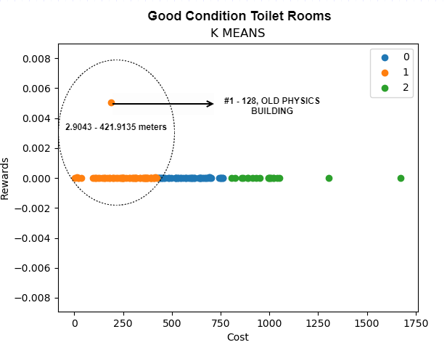
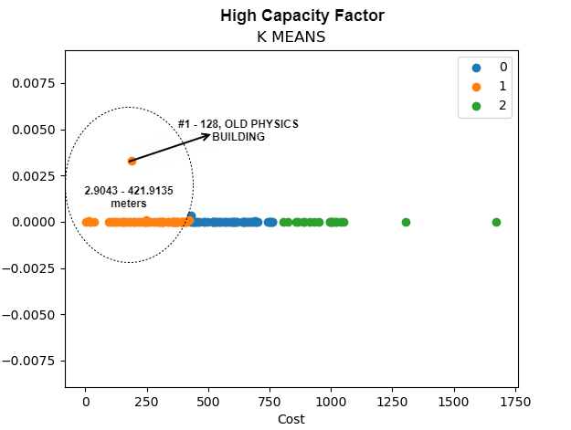
Finding k-most optimal buildings - Toilet Rooms Objective
Redmond Barry Building, Parkville
Results: Spatial Algorithm Findings

Slide 41
Finding k-most optimal buildings - Toilet Rooms Objective
Other Buildings
Glyn Davis Building, Parkville: A staff member needs to walk at least 14-314 metres (Budget)
Old Physics Building is the most rewarding building with cost 668 metres
Old Arts Building, Parkville: A staff member needs to walk at least 3-279 metres (Budget)
Alan Gilbert Building is the most rewarding building with Covid-19 Strict Lockdown factor
Medical Building, Parkville: A staff member needs to walk at least 15-214 metres (Budget)
Old Physics Building is the most rewarding building for with high capacity factor
Werribee Pathology Building, Werribee: A staff member needs to walk at least 154 metres (Budget)
Werribee Dog Colony building is the most rewarding building with cost 33 metres
This can be further extended to other buildings and more campuses
Results: Spatial Algorithm Findings

Slide 42
Finding k-optimal nearest floors
Law Building, Parkville
Other Buildings
Meeting Rooms Objective

Slide 43
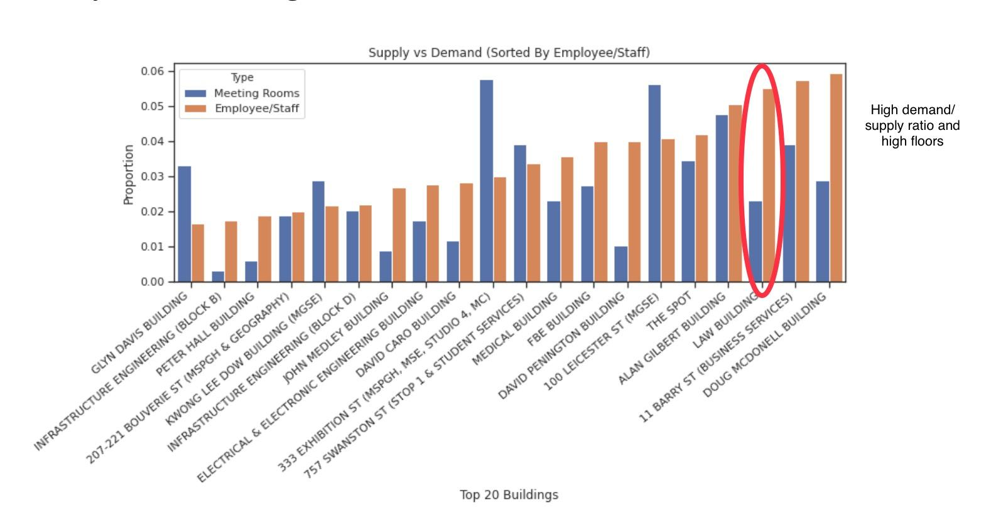
Finding k-most optimal floors - Meeting Rooms Objective
Law Building, Parkville
High demand/supply ratio and high floors
Results: Floor Algorithm Findings

Slide 44
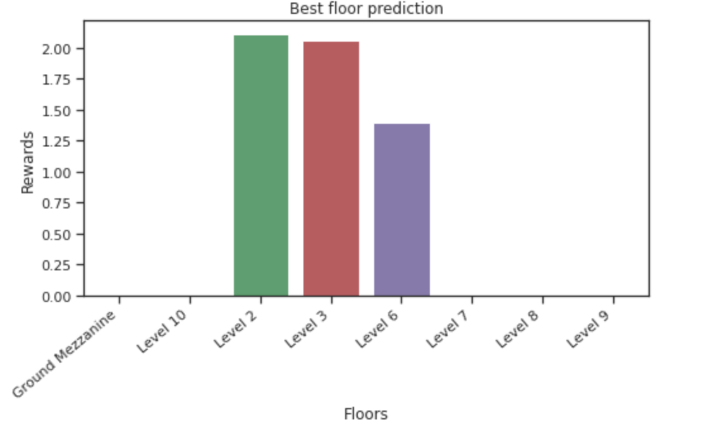
Finding k-most optimal floors - Meeting Rooms Objective
Law Building, Parkville
A staff member needs to walk at least 1-5 levels (Budget) in Law Building to get most rewarding floors with adequate supply of meeting rooms
Results: Floor Algorithm Findings

Slide 45
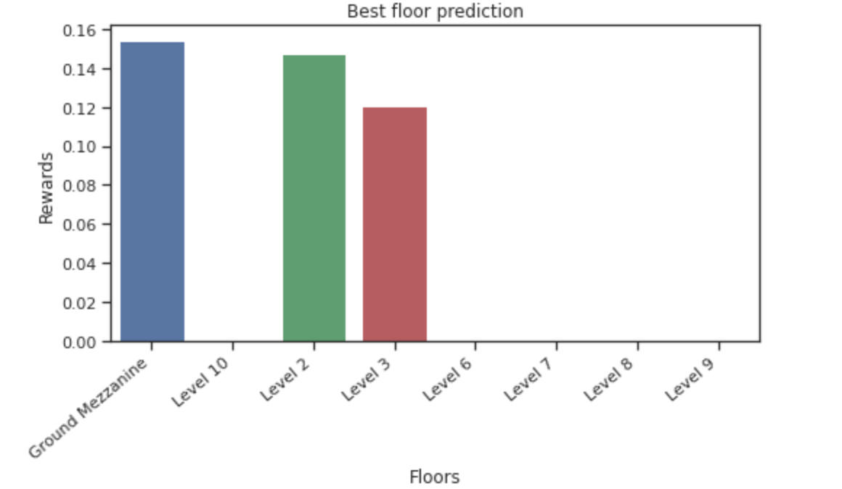
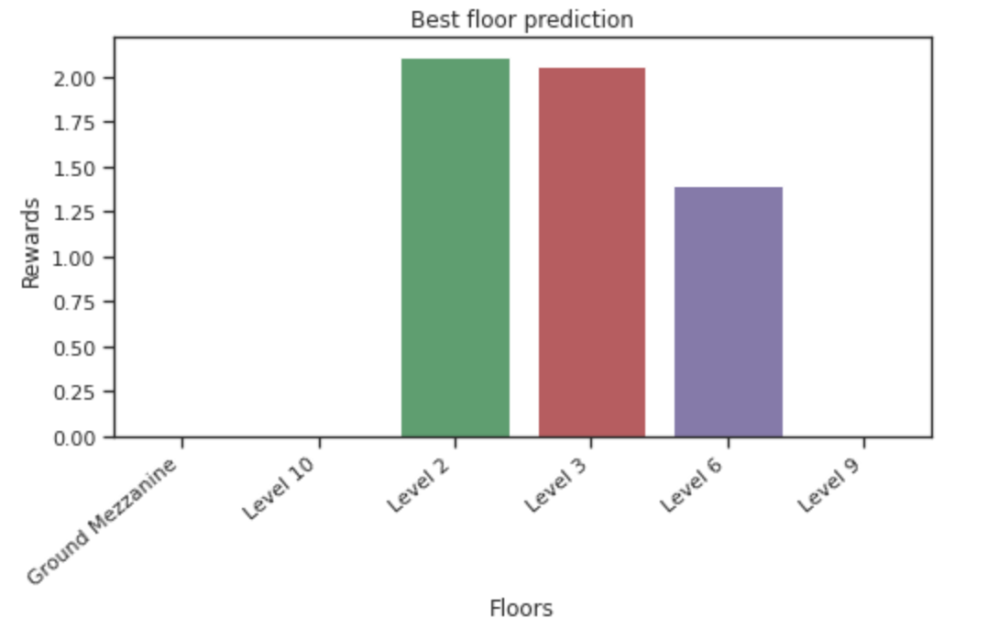
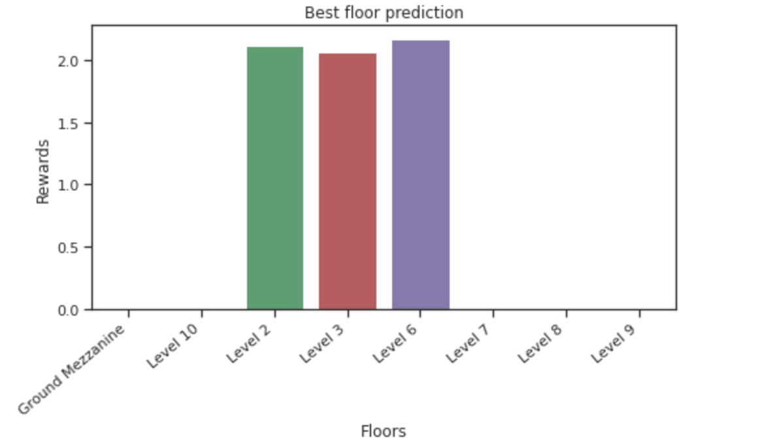
Finding k-most optimal floors - Meeting Rooms Objective
Law Building, Parkville
COVID-19 Strict Lockdown Factor High Capacity Factor Excellent Room Factor
Results: Floor Algorithm Findings

Slide 46
Finding k-most optimal floors - Meeting Rooms Objective
Other Buildings
Alan Gilbert Building, Parkville: A staff member needs to walk at least 1-4 levels (Budget)
Level 5 is the most rewarding floor with cost 4 floors
100 Leicester St, Parkville: A staff member needs to walk at least 1-6 levels (Budget)
Level 2 is the most rewarding floor with COVID-19 Lockdown factor and cost 1 floor
Stop 1 & Student Services, Parkville: A staff member needs to walk at least 1-5 levels (Budget)
Level 6 is the most rewarding floor with equipment factor and cost 5 floors
Werribee Veterinary Hospital, Werribee: A staff member needs to walk at least 1 level (Budget)
Ground floor is the most rewarding floor with cost 1 floor
This can be further extended to other buildings and more campuses
Results: Floor Algorithm Findings

Slide 47
Finding k-optimal nearest floors
Glyn Davis Building, Parkville
Other Buildings
Toilet Facilities Objective

Slide 48
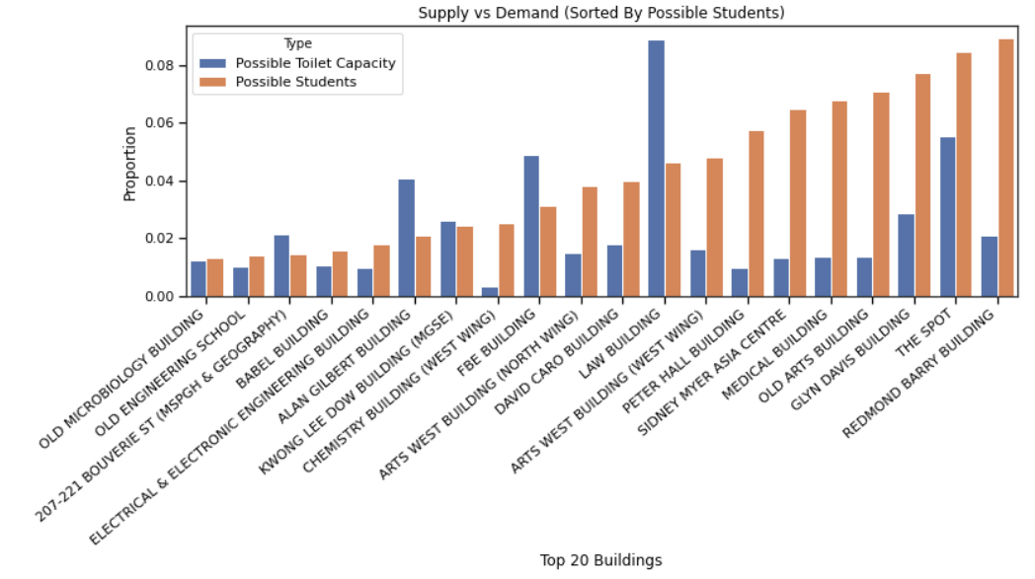
Finding k-most optimal floors - Toilet Rooms Objective
Glyn Davis Building, Parkville
High Demand & Low Supply
6 Floors
Results: Spatial Algorithm Findings

Slide 49
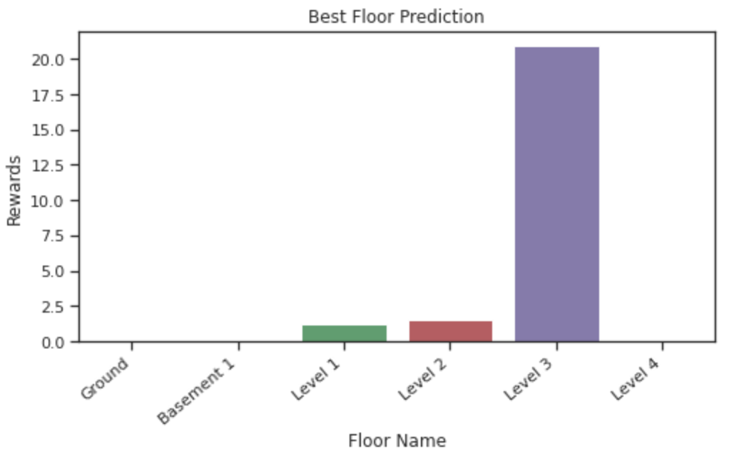
Finding k-most optimal floors - Toilet Rooms Objective
Glyn Davis Building, Parkville
A student needs to walk at least 1-3 levels in Glyn Davis Building to get most rewarding floors with adequate supply of toilet rooms
Results: Spatial Algorithm Findings

Slide 50
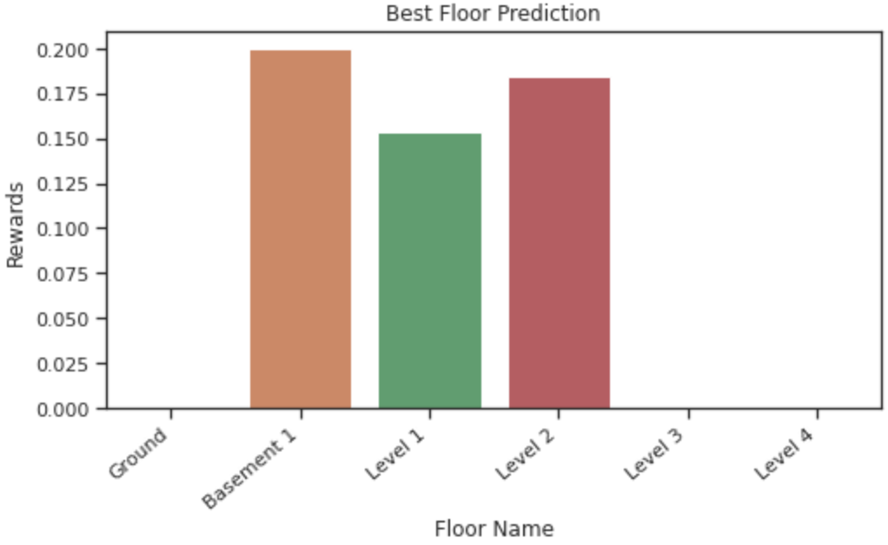
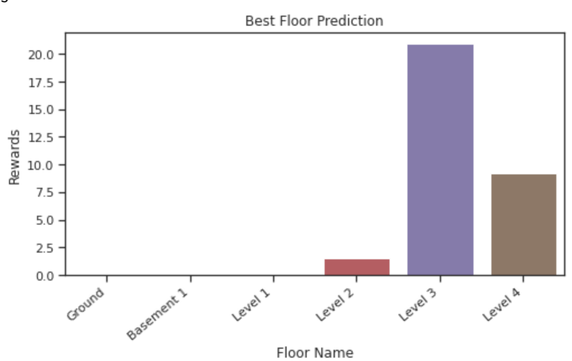
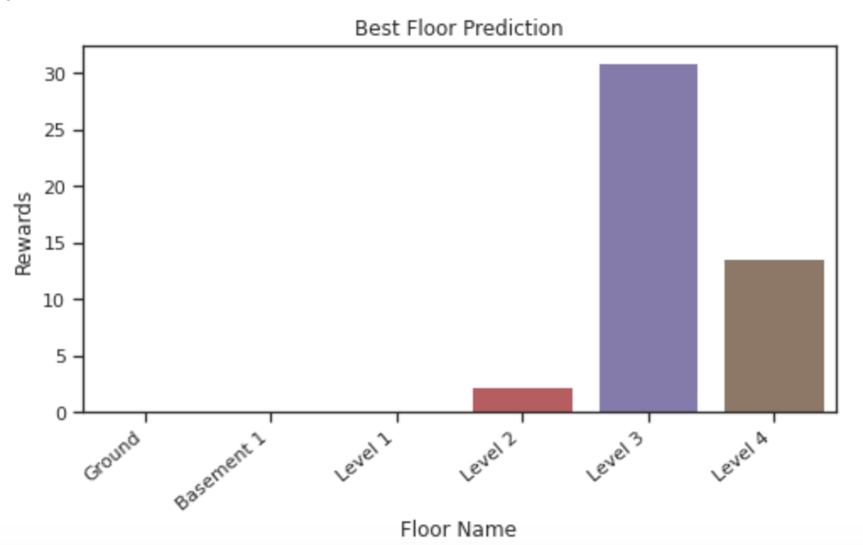
Finding k-most optimal floors - Toilet Rooms Objective
Glyn Davis Building, Parkville
COVID-19 Strict Lockdown
Excellent Room Condition
High Capacity
Results: Spatial Algorithm Findings

Slide 51
Finding k-most optimal buildings - Toilet Rooms Objective
Other Buildings
Redmond Barry Building, Parkville: A student needs to walk at least 2-4 Floors
Level 4 is the most rewarding floor with cost 2 floors
The Spot, Parkville: A student needs to walk at least 1-3 Floors
Level 1 is the most rewarding floor with high capacity factor, cost 2 floors
David Caro Building, Parkville: A student needs to walk at least 1-3 Floors
Level 1 is the most rewarding floor with easy availability factor, cost 3 floors
Old Microbiology, Parkville: A student needs to walk at least 1-2 Floors
Level 2 is the most rewarding floor with cost 1 floor
This can be further extended to other buildings and more campuses
Results: Floor Algorithm Findings

Slide 52
Algorithm Analysis
Applications, Requirements and Limitations

Slide 53
Algorithm Applications
Recommendation Systems
Ability to recommend entities based on cost and reward modelling
Efficient Resource Allocation
Utilising cost constraint, rewards can be distributed efficiently
Generic Rewards Modelling
Reward function can be enhanced to include any domain-related factors
Ability to map any domain-related orienteering problem
Algorithm is very generic
Require cost and reward function domain-related implementation
Algorithm Analysis

Slide 54
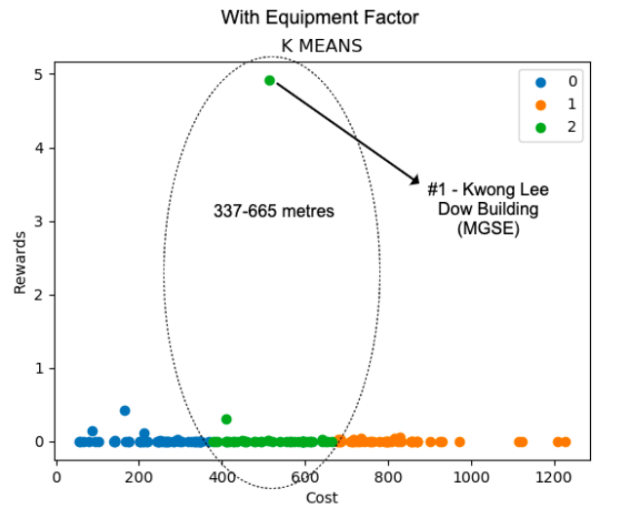
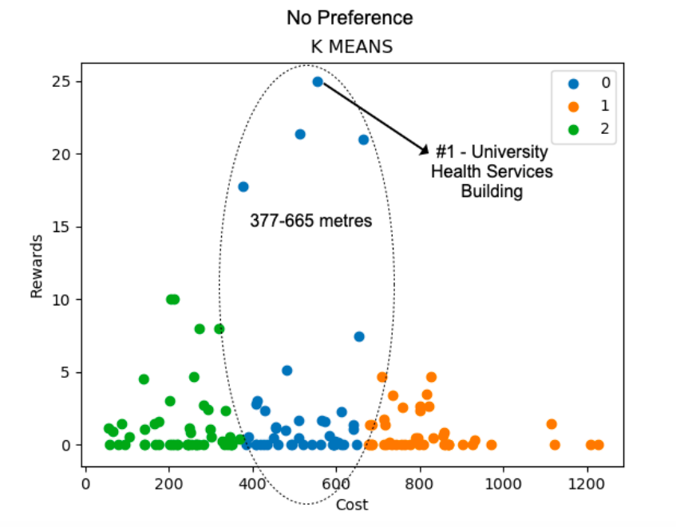
Algorithm Data Requirements
Data needs to be properly provided for nodes
Imbalanced/Missing data will cause biased results
Imbalanced/Missing Data
Provided Data
Algorithm Analysis

Slide 55
Algorithm Limitations
Our algorithm relies on the assumption that the graph is a specialized weighted directed graph with one central node (0 in-degree and n out-degree) and n isolated nodes connected with only one central node.
Due to this assumption, the algorithm is efficient and applicable only for such versions of the specialized graph and cannot be extended implicitly to any general weighted directed graph.
Future Improvements

Slide 56
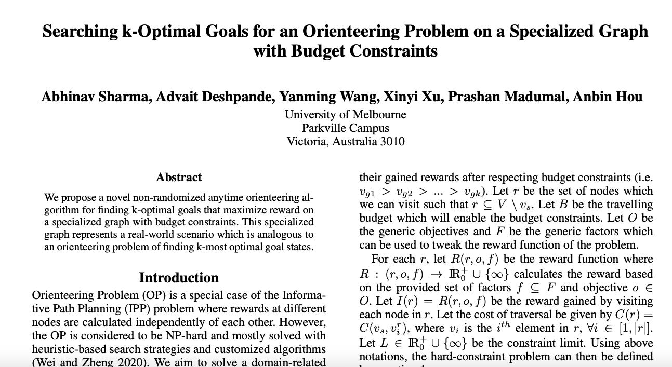
Achievement
Proposed novel algorithm is submitted to 35th AAAI Conference on Artificial Intelligence
Student Abstract Program
Constraint Satisfaction Track

Slide 57
Conclusion
Suggested how the space arrangement of meeting rooms and toilets can be optimized
Completed a detailed analysis report with interpretations
Used different analytical methods
Provided reasonable recommendations of space optimization opportunities
Expected Outcomes Achieved

Slide 58
Thank You
Group 3
Abhinav Sharma
Advait Deshpande
Xinyi Xu
Yanming Wang
MAST90107

